Slide 1
HealthConnect Clinical Analysis
Week 6 | Advanced Analytics & Decision Support
Data Analytics Track
APPOINTMENTS ANALYSED
5,000
18 variables
OVERALL NO-SHOW RATE
48.5%
Week 5 baseline
CROSS-TRACK INTEGRATION
Data Science
Feature engineering + validation
HealthConnect | Data Analytics | Week 6

Slide 2
Week 5 → Week 6: From Findings to Decision Support
Week 6 required deeper analysis, validation, dashboard improvement and meaningful cross-track integration.
Week 5 established the baseline: overall no-show rate, lead-time patterns, previous no-show history, reminders and appointment segments.
Week 6 focused on testing how these factors interact and whether the strongest descriptive findings remain useful when considered together.
The Data Science track independently recomputed the key findings and used two analytics suggestions in feature engineering.
The goal was not to repeat the Week 5 dashboard, but to turn the strongest findings into validated and actionable decision support.
ADVANCED ANALYSIS
Interactions
History × lead time
VALIDATION
Replicated
Data Science recomputation
INTEGRATION
Adopted
2 feature suggestions
HealthConnect | Data Analytics | Week 6

Slide 3
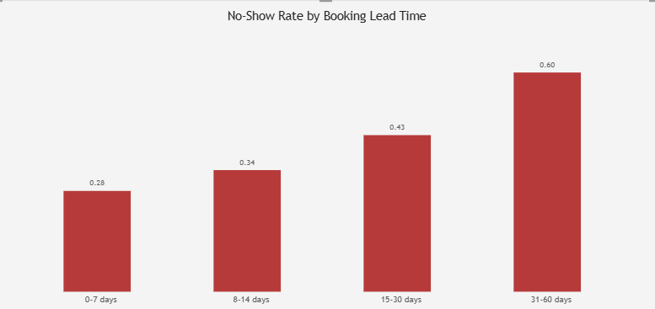
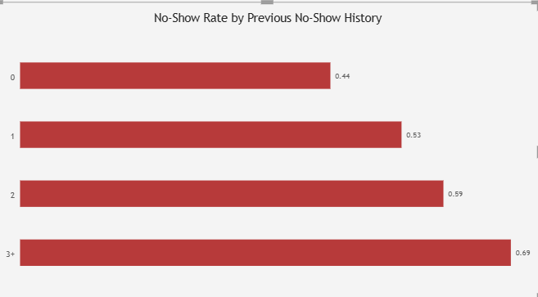
Key Advanced Findings
The strongest patterns from Week 5 became more useful when examined across segments.
Both patterns increase materially with greater prior no-show history and longer booking lead time, making them strong candidates for targeted decision support.
HealthConnect | Data Analytics | Week 6

Slide 4
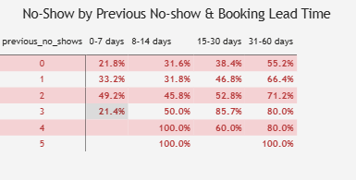
Interaction Analysis: Previous No-Shows × Booking Lead Time
The combined view shows that risk rises when the two factors occur together.
For patients with 0 previous no-shows, the no-show rate rises from 21.8% at 0–7 days to 55.2% at 31–60 days.
For patients with 2 previous no-shows, the rate reaches 71.2% in the 31–60 day band.
The highest observed cells are concentrated among patients with prior no-shows and longer lead times.
This interaction was directly useful to Data Science: a previous_no_shows × booking_lead_days interaction was tested and retained.
HealthConnect | Data Analytics | Week 6

Slide 5
Cross-Track Validation: Data Analytics vs Data Science
The Data Science team independently recomputed the four quantitative findings.
Finding | Data Analytics | Data Science recomputation | Validation
Previous no-shows | 43.5% → 68.8% | 46.3% → 70.3% | Replicated closely
31–60 day lead time | 60.5% | 63.9% | Same direction
Reminder: Yes vs No | 47.4% vs 51.4% | 49.9% vs 54.6% | Same direction
Distance ≥20 km | 57.3% | 60.2% | Same direction
KEY VALIDATION
Same underlying patterns
All four findings replicated closely
IMPORTANT NUANCE
Descriptive ≠ predictive
Previous no-shows strongest descriptively
MODEL VIEW
Lead time + distance ranked higher
Multivariate importance can differ
HealthConnect | Data Analytics | Week 6

Slide 6
What Changed Because of the Integration
The collaboration produced a measurable modelling change, not just an exchange of information.
FEATURE CHANGE 1
Lead-time band
0–7 / 8–14 / 15–30 / 31–60 days tested alongside continuous booking_lead_days
FEATURE CHANGE 2
History × lead time
previous_no_shows × booking_lead_days interaction tested
MODEL RESULT
ROC-AUC 0.680 → 0.682
Both additions retained after measurable improvement
Data Analytics provided the lead-time bands and evidence that prior no-show behaviour interacts with longer booking horizons.
Data Science incorporated both suggestions into feature engineering and retained them in the Week 6 candidate model.
The model also highlighted an important distinction: booking lead time and distance ranked above previous no-shows in predictive importance.
Interpretation: previous no-show history is a strong descriptive signal, while its incremental predictive contribution is partly absorbed by correlated variables in a multivariate model.
HealthConnect | Data Analytics | Week 6

Slide 7
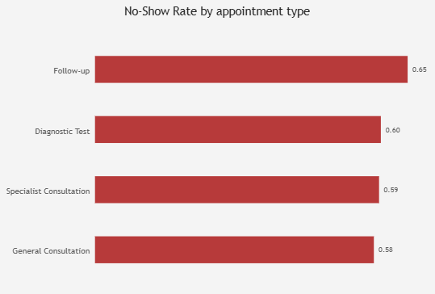
Additional Analysis: 31–60 Day Lead Time by Appointment Type
This directly addresses the additional analytical requirement identified by Data Science.
The elevated 31–60 day no-show pattern is consistent across all four appointment types.
Follow-up appointments are highest at 65.1%.
General Consultation is lowest at 58.1%, but remains materially high.
This suggests the long-lead-time effect is not concentrated in only one appointment type.
DECISION SUPPORT IMPLICATION
Prioritise long-lead appointments
Use stronger confirmation/support across appointment types
HealthConnect | Data Analytics | Week 6

Slide 8
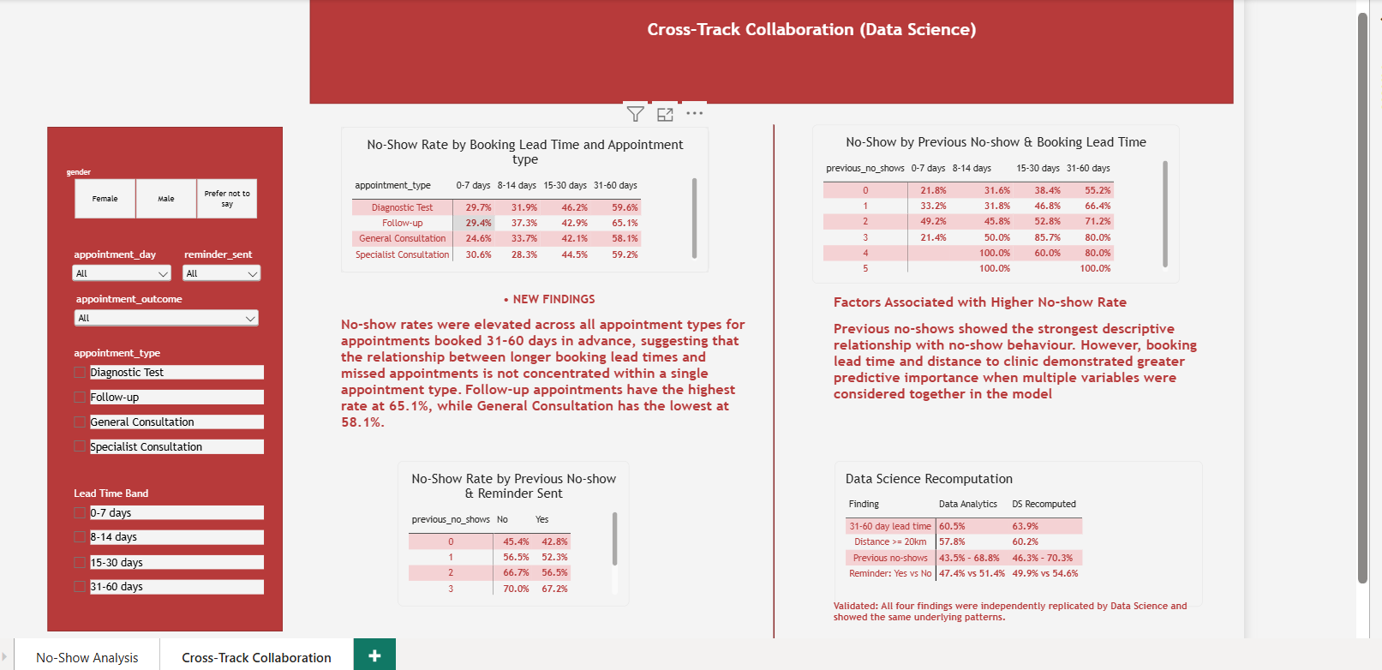
Dashboard Update and Week 7 Focus
The dashboard now supports decision-making by combining segment interactions with cross-track validation.
Keep the current interaction visuals: appointment type × lead time, previous no-shows × lead time, and previous no-shows × reminder.
Add a small cross-track validation panel showing Data Analytics vs Data Science recomputed figures.
For Week 7, test whether the candidate model and analytical recommendations remain stable on new or held-out data and monitor intervention performance.
HealthConnect | Data Analytics | Week 6

